Slide 1
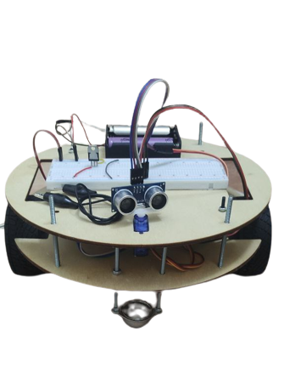


Slide 2
Syllabus
-Our team
-Overview
-BOM
-Circuit diagram
-Used peripherals

Slide 3
Group 525 Maadi
Project : Autonomous Car
Our team:
-Hussein
-Abdulrahman
-Younes

Slide 4
Overview
-A self driving car is designed which can avoid any obstacles with a very fast response.
-The project combines software and hardware components to design a smart car which can move safely through its surroundings

Slide 5

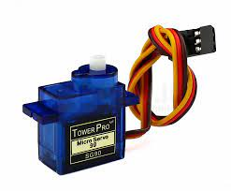
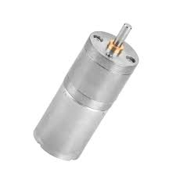
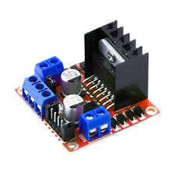
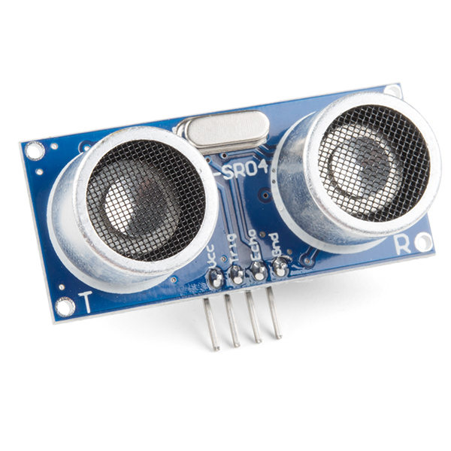
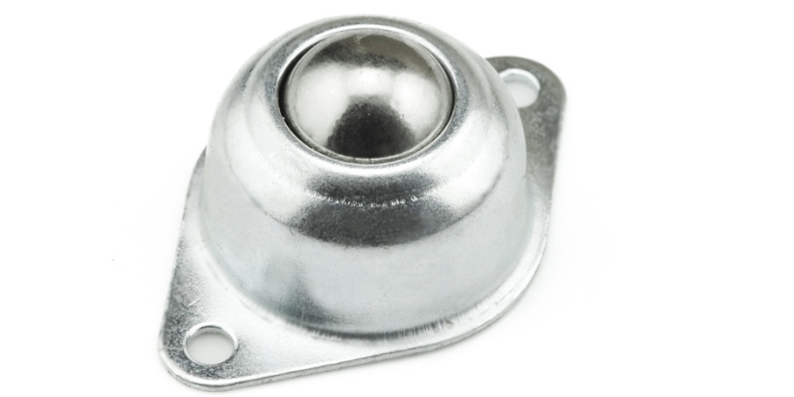
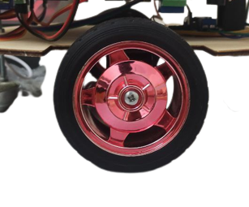
bracket
Servo
motor
BOM
Motor driver
ultrasonic
caster
wheel

Slide 6
bracket
motor
Servo
Motor driver
ultrasonic
caster
wheel

Slide 7
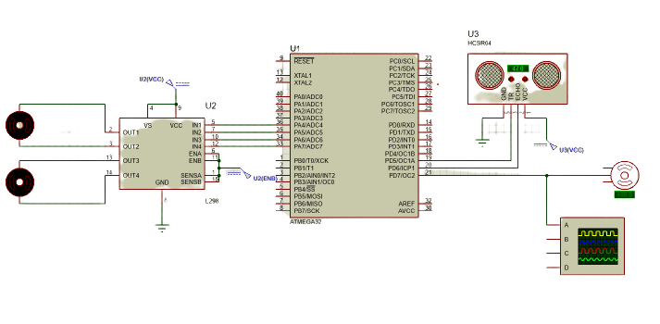
Circuit diagram

Slide 8
Used peripherals
-DIO
-Timer 2
-Timer 1

Slide 9
Used peripherals
-DIO
Used to initialize microcontroller ports and to drive the DC motor

Slide 10
Used peripherals
-Timer 2
Used as PWM driver to control the servo motor

Slide 11
Used peripherals
-Timer 1
Used as input capture to calculate the time taken by ultrasound to go back and forth then calculate the distance based on the speed of sound

Slide 12
